Slide 1
Computer Organization and Assembly Fall 2019
Lecture 23
All Slides are courtesy by Dr Haroon
Syeda Farwa Batool

Slide 2
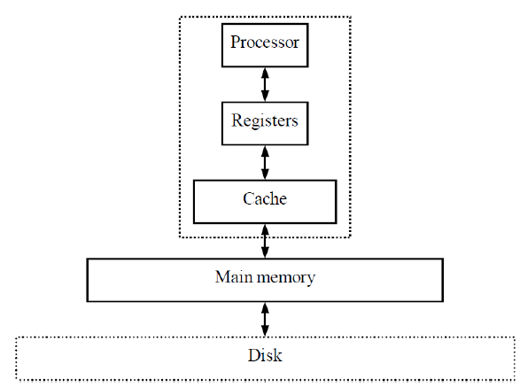
Memory Hierarchy
Out Motive: Want inexpensive, fast memory
Main memory
Large, inexpensive, slow
memory stores entire
program and data
Cache
Small, expensive, fast
memory stores copy of likely
accessed parts of larger memory
Can be multiple levels of cache

Slide 3
Cache
Usually designed with SRAM
faster but more expensive than DRAM
Usually on same chip as processor
space limited, so much smaller than off-chip main memory
faster access ( 1 cycle vs. several cycles for main memory)
Cache operation:
Request for main memory access (read or write)
First, check cache for copy

Slide 4
Cache
Cache hit
copy is in cache, quick access
Cache miss
copy not in cache, read address and possibly its neighbors into cache
Several cache design choices
cache mapping
replacement policies
write techniques

Slide 5
Problem 1
Assume a program that has:
cache access times of 1-cyc (L1), 10-cyc (L2), 30-cyc (L3), and 300-cyc (memory)
and Misses Per Kilo Instructions (MPKIs) of 20 (L1), 10 (L2), and 5 (L3).
Find the total memory access time.
Find memory access time without L3.
With L3: 1000 + 10x20 + 30x10 + 300x5 = 3000
Without L3: 1000 + 10x20 + 10x300 = 4200

Slide 6
Cache mapping
Far fewer number of available cache addresses
Are address’ contents in cache?
Cache mapping used to assign main memory address to cache address and determine hit or miss
Three basic techniques:
Direct mapping
Fully associative mapping
Set-associative mapping

Slide 7
Direct mapping
Main memory address divided into 2 fields
Index
cache address
number of bits determined by cache size
Tag
compared with tag stored in cache at address indicated by index
if tags match, check valid bit
Valid bit
indicates whether data in slot has been loaded from memory
Offset
used to find particular word in cache line

Slide 8
Memory Locality
Memory hierarchies take advantage of memory locality.
Memory locality is the principle that future memory accesses are near past accesses.
Memories take advantage of two types of locality
Temporal locality --near in time
we will often access the same data again very soon
Spatial locality --near in space/distance
our next access is often very close to our last access (or recent accesses).

Slide 9
Types of Cache Misses
Compulsory misses:
Happens the first time a memory word is accessed –the misses for an infinite cache
Capacity misses:
Happens because the program touched many other words before re-touching the same word –the misses for a fully-associative cache
Conflict misses:
Happens because two words map to the same location in the cache –the misses generated while moving from a fully-associative to a direct-mapped cache

Slide 10
Problem 1
Assume a direct-mapped cache with just 4 sets. Assume that block A maps to set 0, B to 1, C to 2, D to 3, E to 0, and so on. For the following access pattern, estimate the hits and misses:
A B B E C C A D B F A E G C G A
M M H M M H M M H M H M M M M M

Slide 11
Problem 2
Assume a 2-way set-associative cache with just 2 sets. Assume that block A maps to set 0, B to 1, C to 0, D to 1, E to 0, and so on. For the following access pattern, estimate the hits and misses:
A B B E C C A D B F A E G C G A

